Slide 1
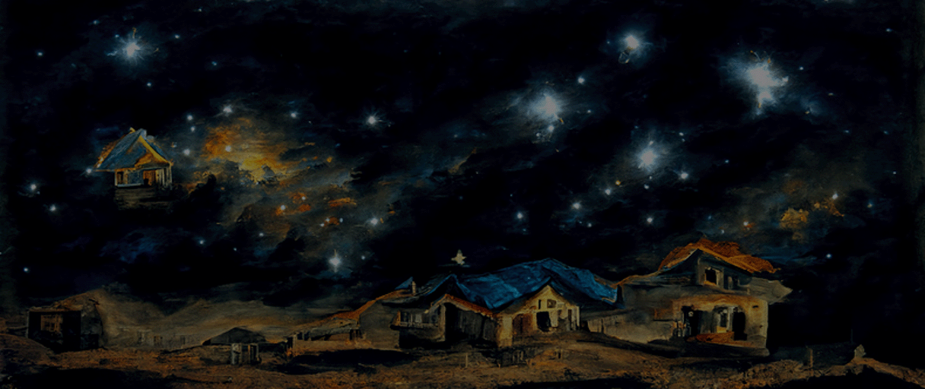


Energy Use in Households
How people in the UK use energy at home in 2020 and 2021?
- Group 11 -

Slide 2







Overview Project Team
University of Edinburgh
Advisor
Dr. Benjamin Bach
Dr. Martin Pullinger
Zonglin Ji
Supervisor
Data Owner
Tutor
University of Edinburgh
Core Team
Xinyuan Feng
Kaihuang Huang
Runyan Gan
Liuyang Chen
Project Team
Project Team
Project Team
Project Team
Research Findings | December, 2022
1

Slide 3
1. Intro
2. Application
3. Findings
4. Next Steps

Slide 4
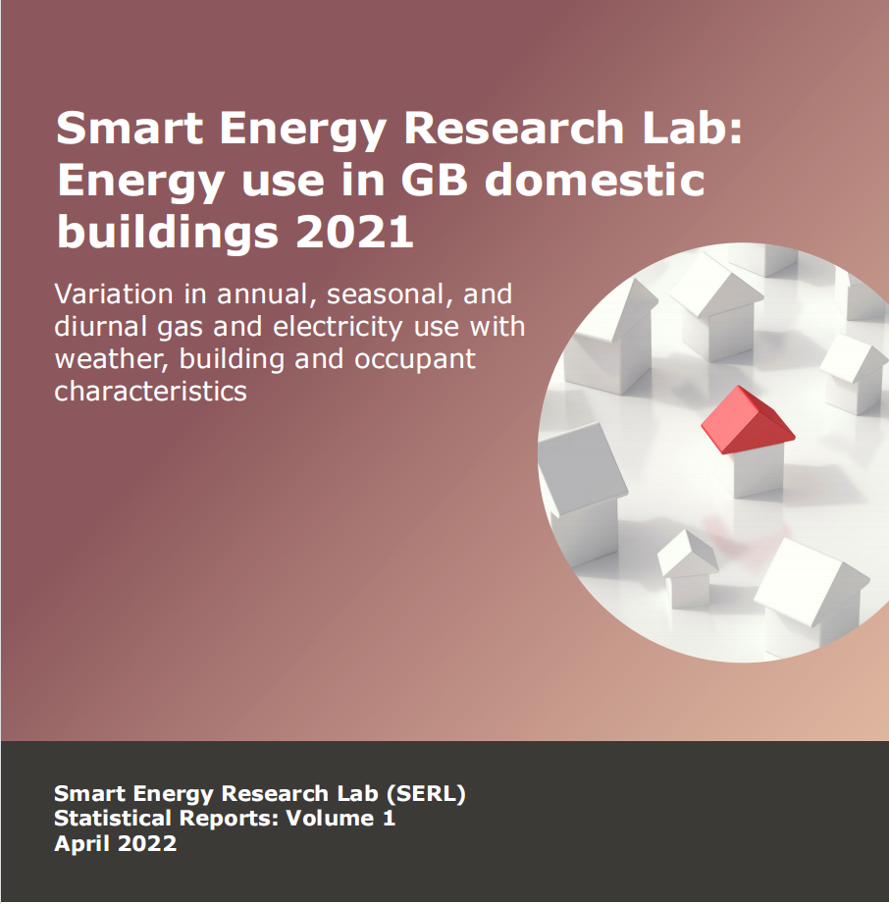
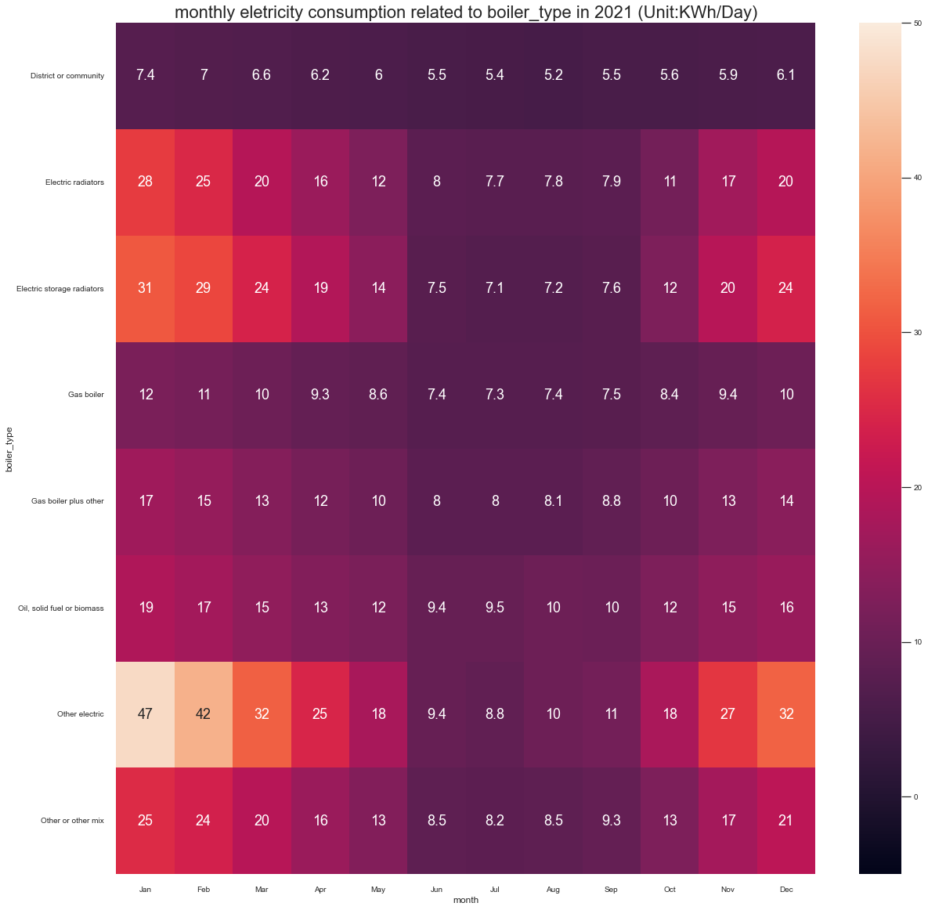
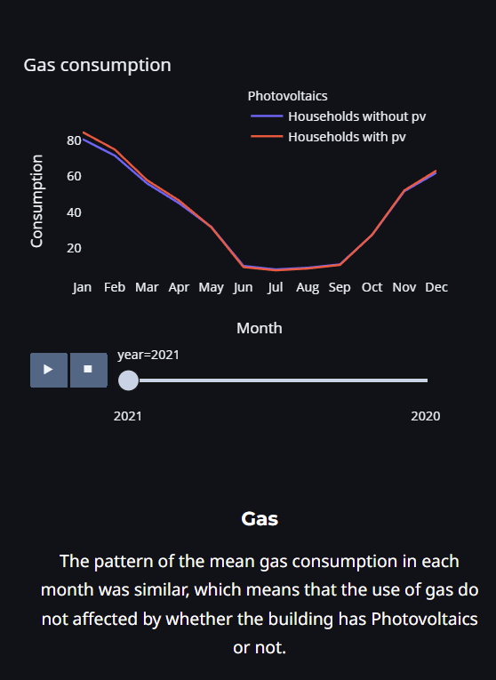
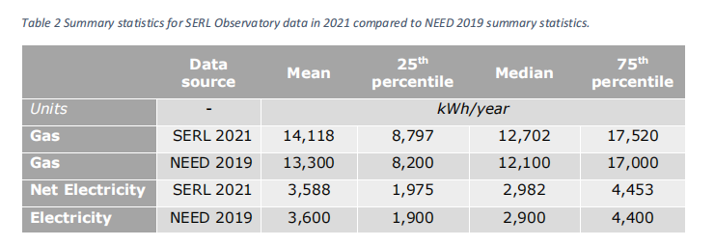
Our Project Goal is to satify potential users’ needs, improve the visualization of the original report and dig deeply on some data.
Improve the visualization
&
Dig Deeply on Data
Previous
Basic
Report
Research Findings | December, 2022
3

Slide 5

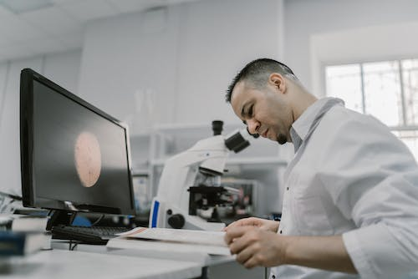



We hypothesize that our potential audience could be divided into 4 types.
User
Type 1
Researchers
User
Type 2
Government
Officers
User
Type 3
Energy
Suppliers
User
Type 4
Common
Users
Conduct research on the energy consumption habits
Find documents as a reference for the policy
Use it as a reference for deciding the energy price and storage
Interested at the energy consumption information
Research Findings | December, 2022
2

Slide 6

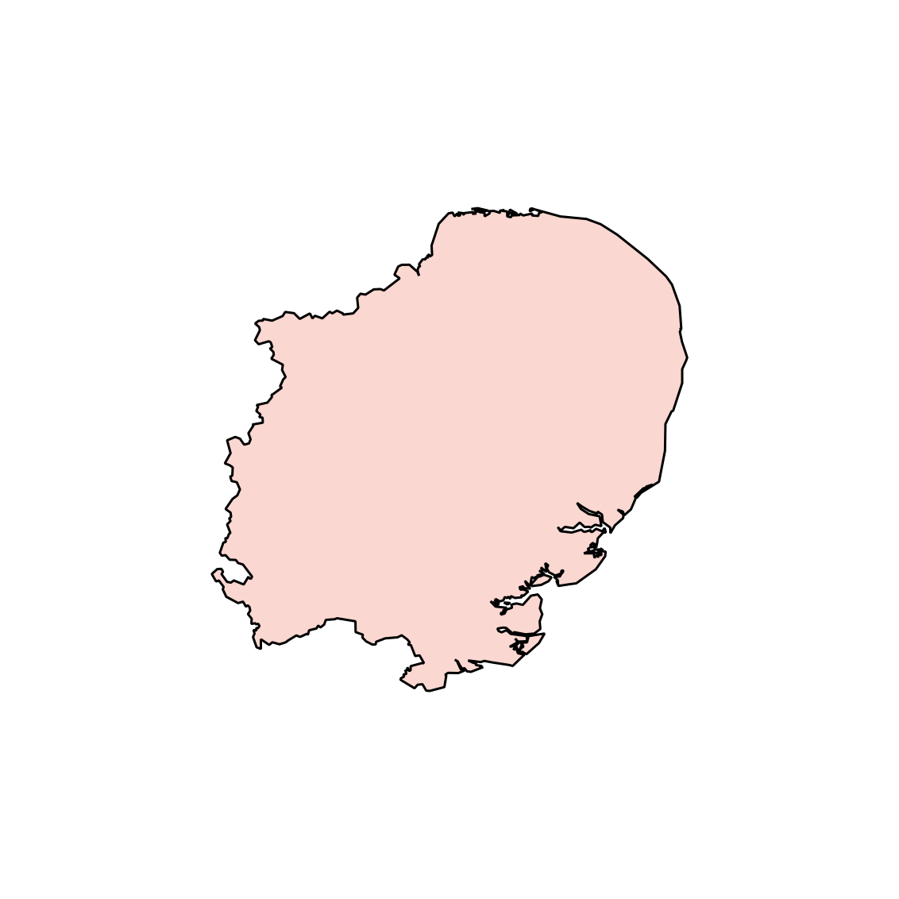
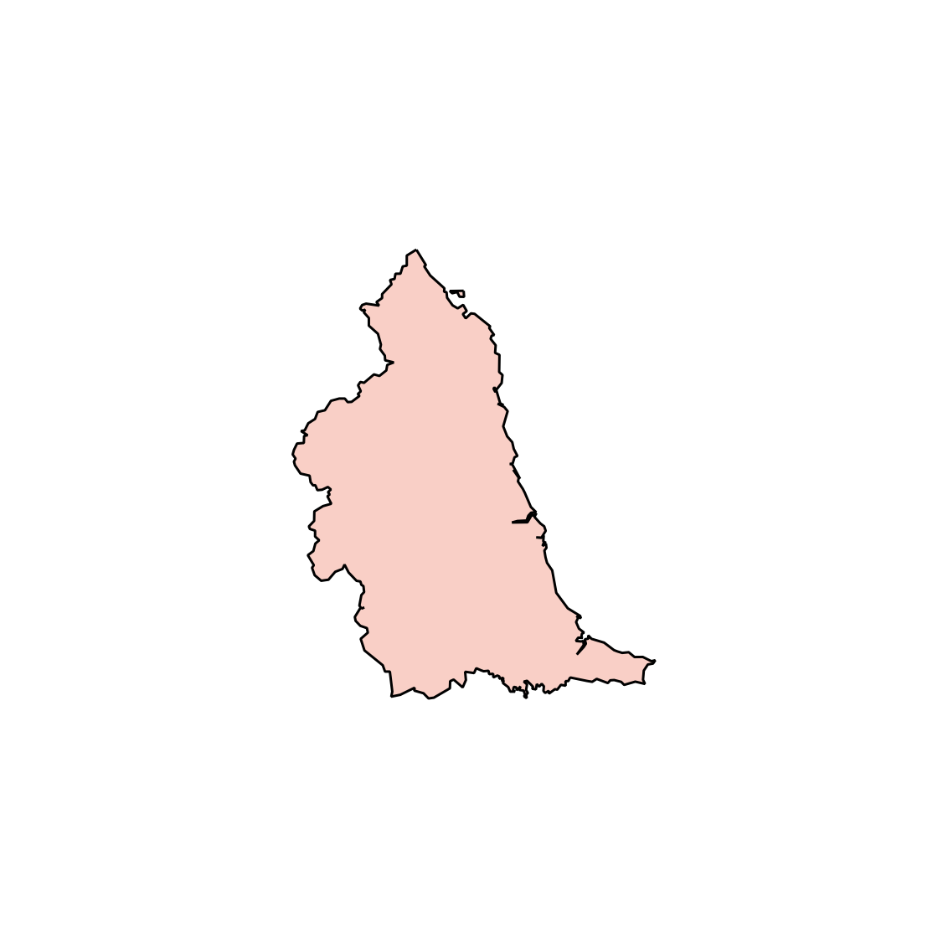
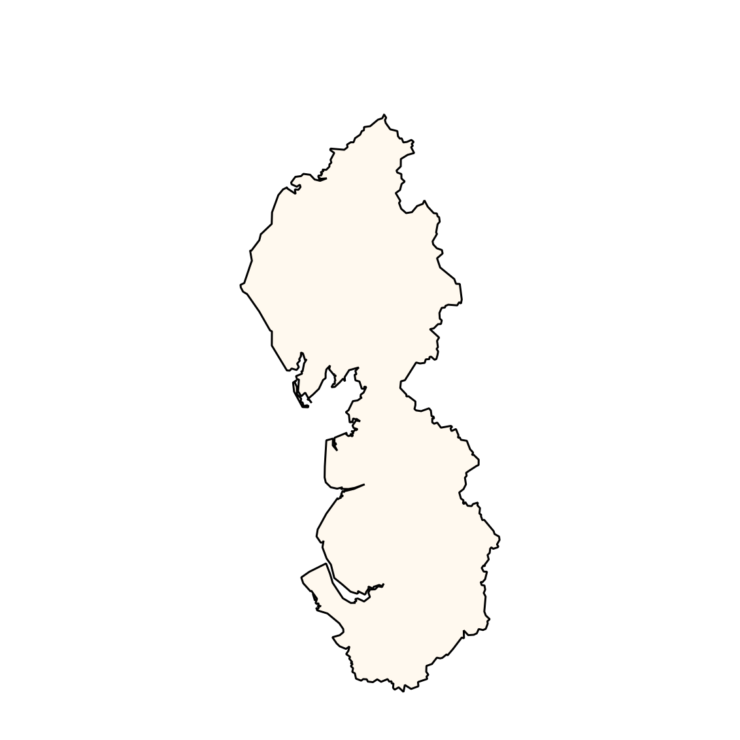
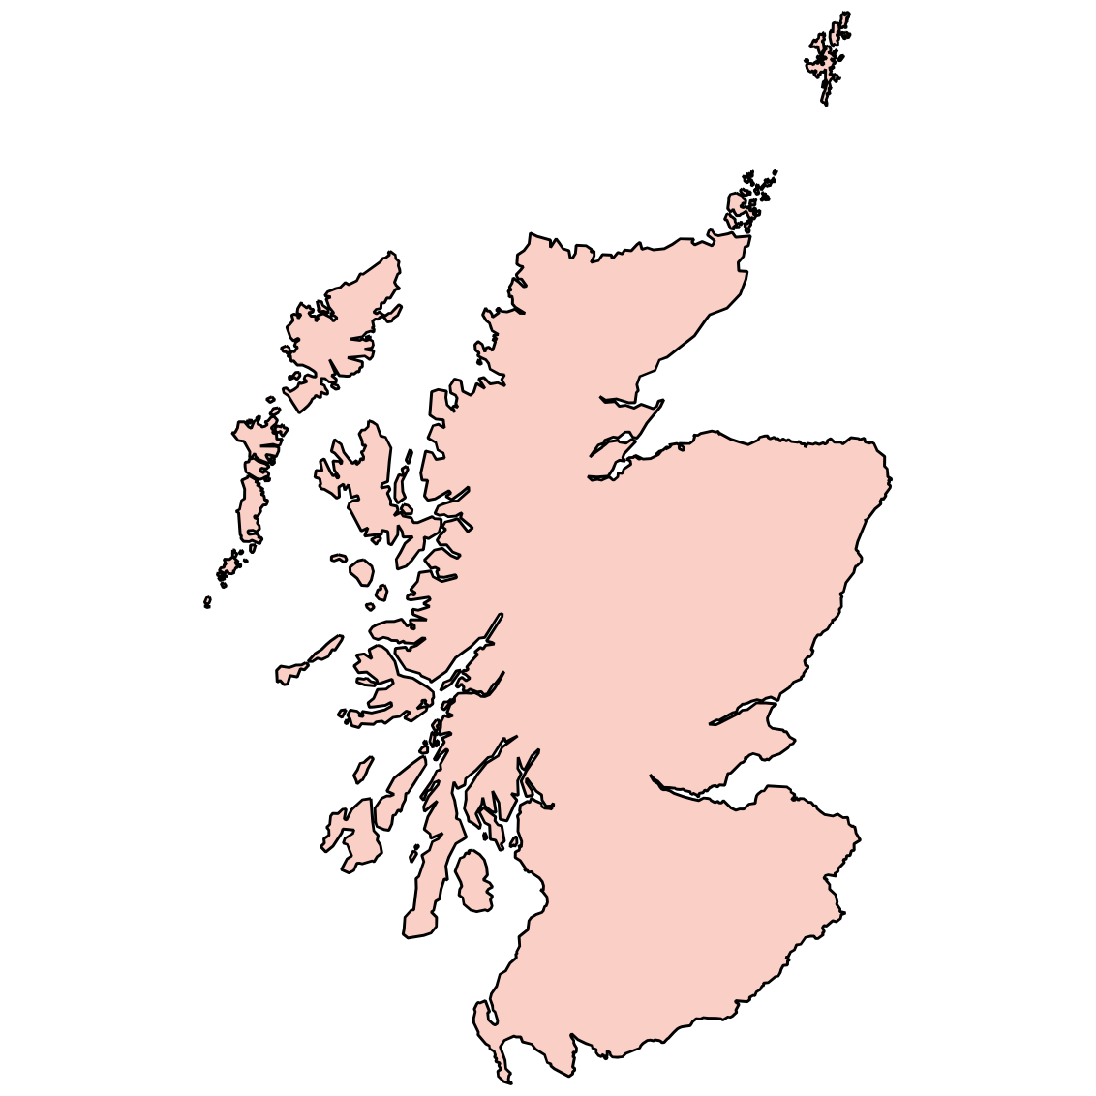
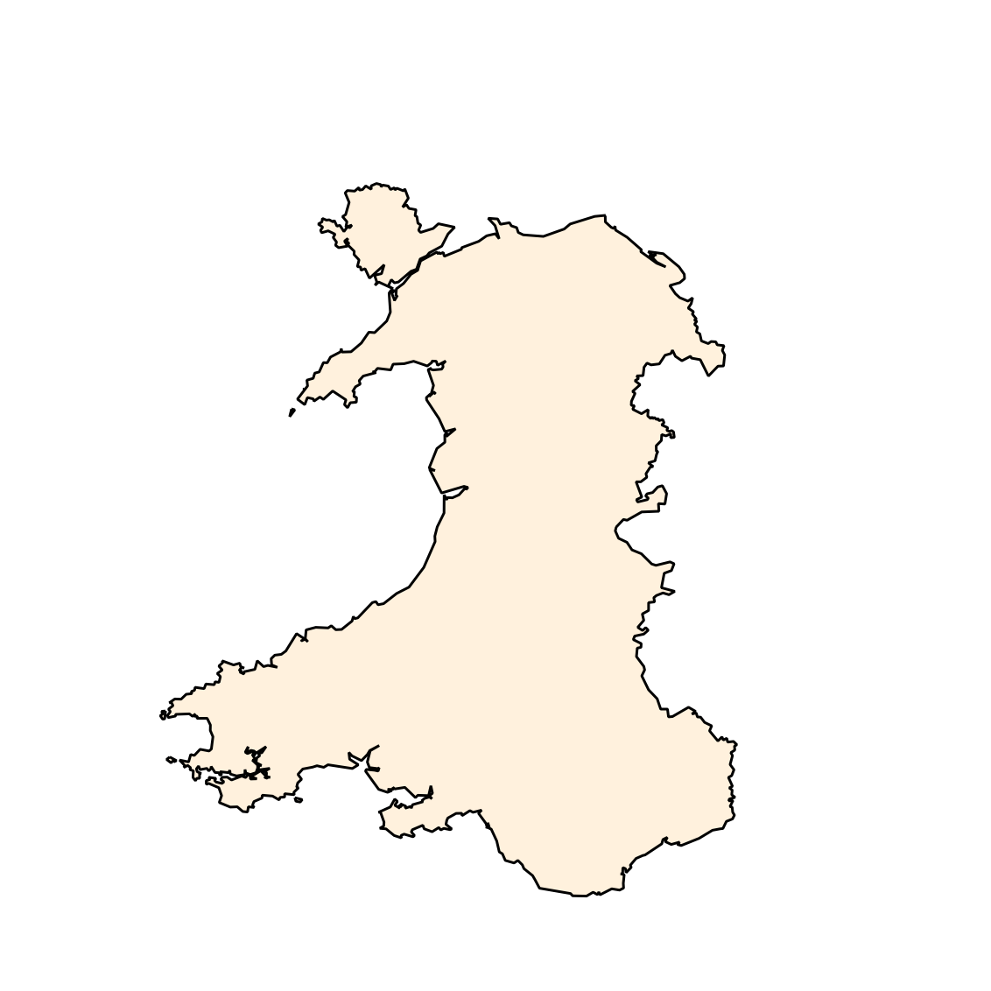
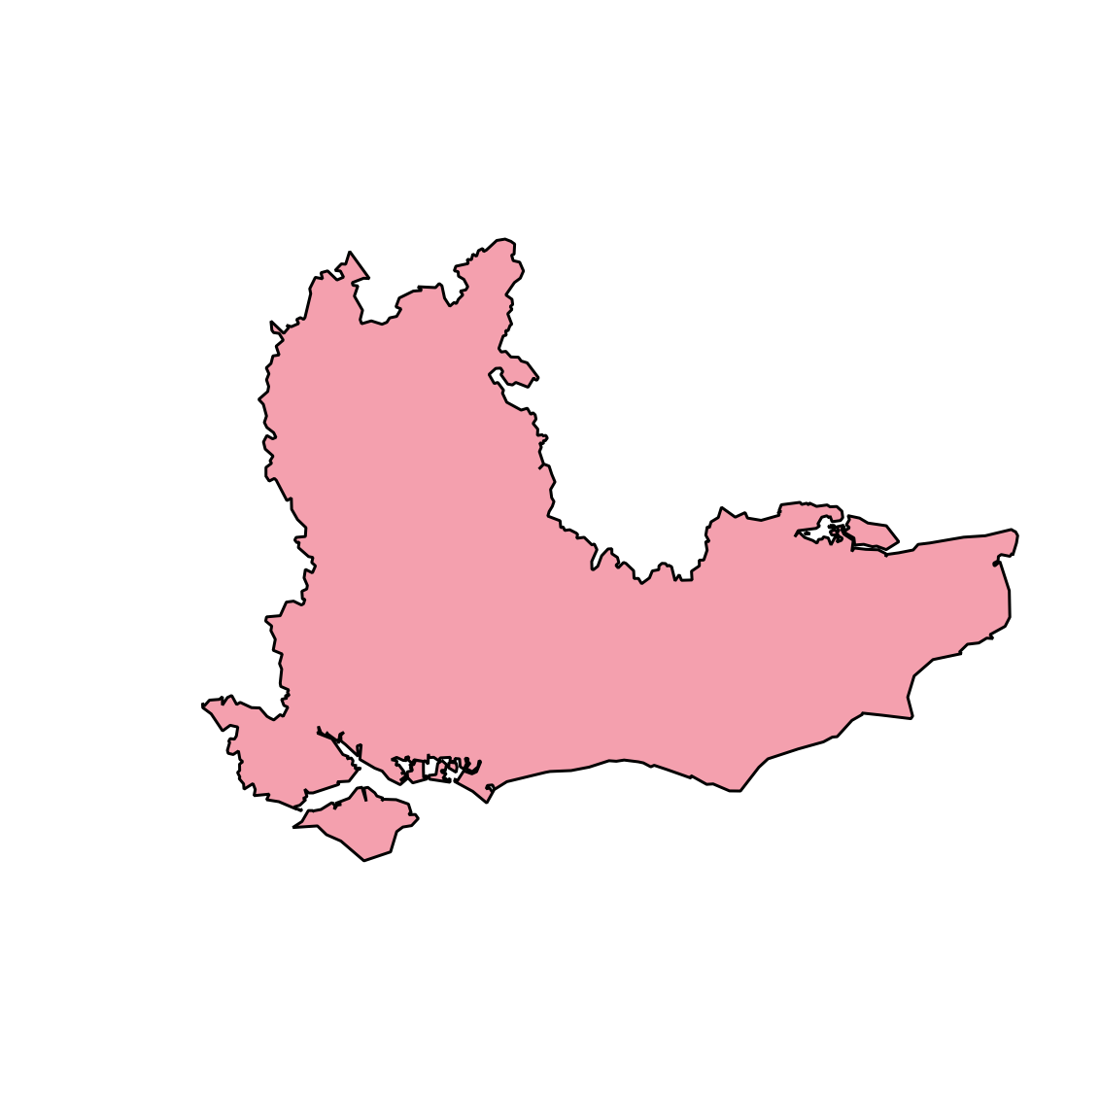
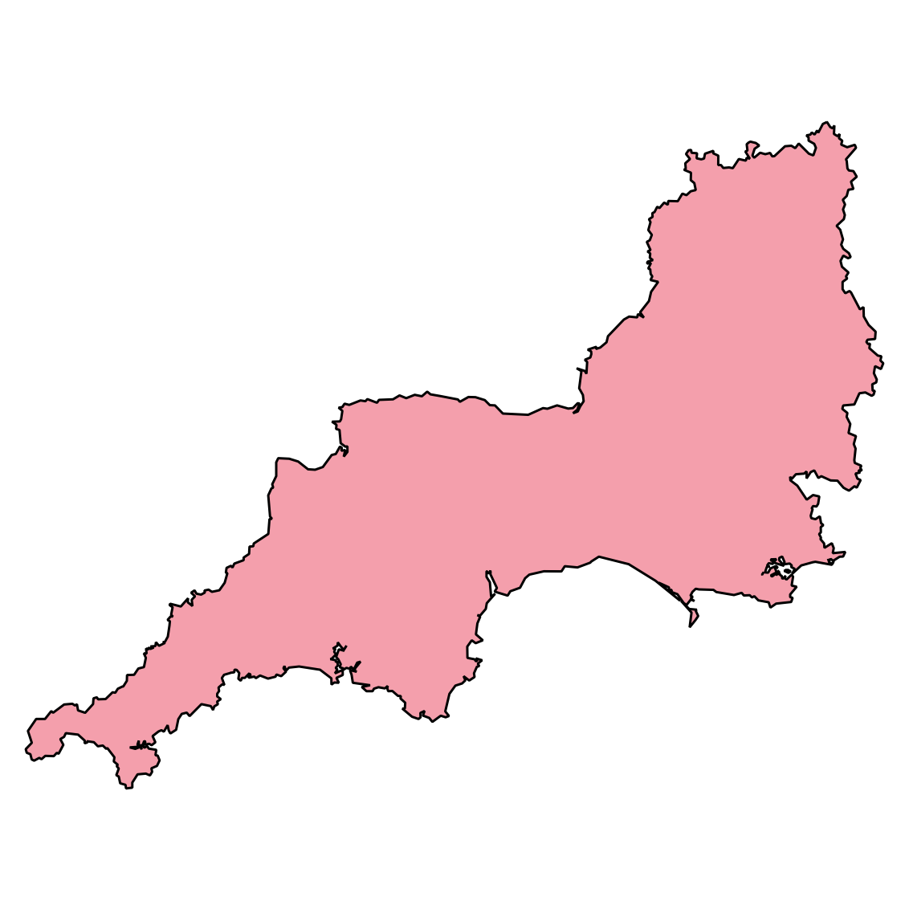
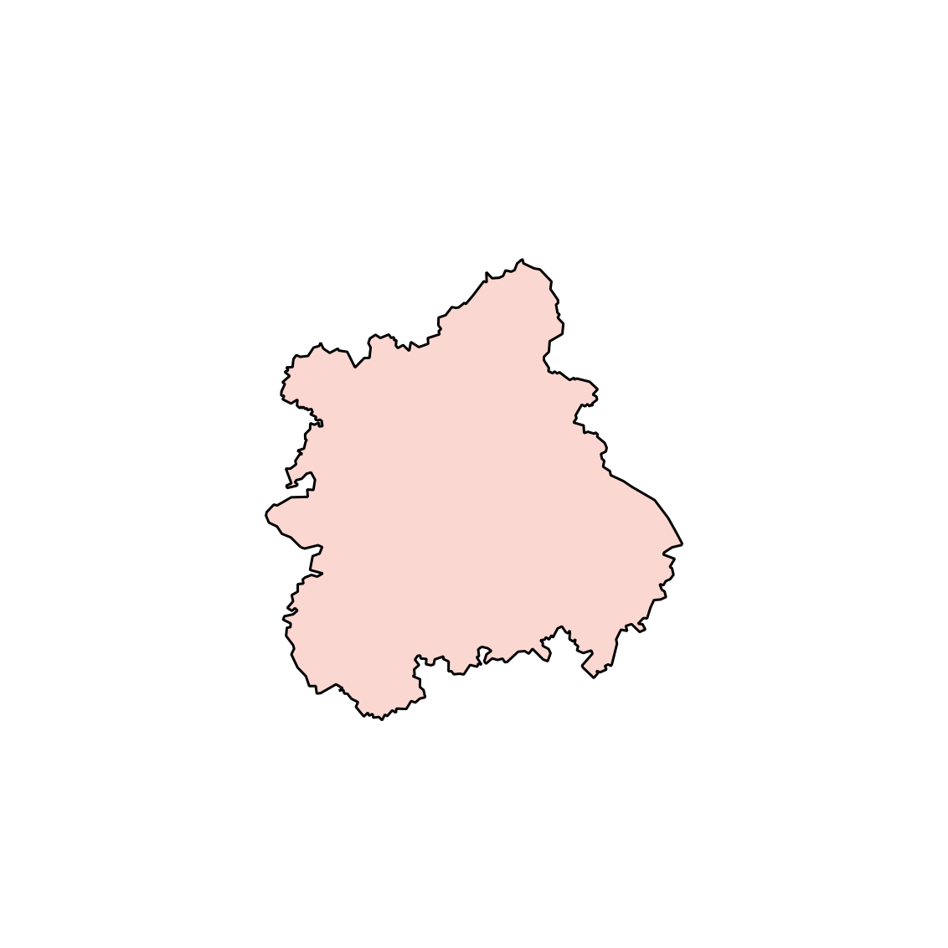


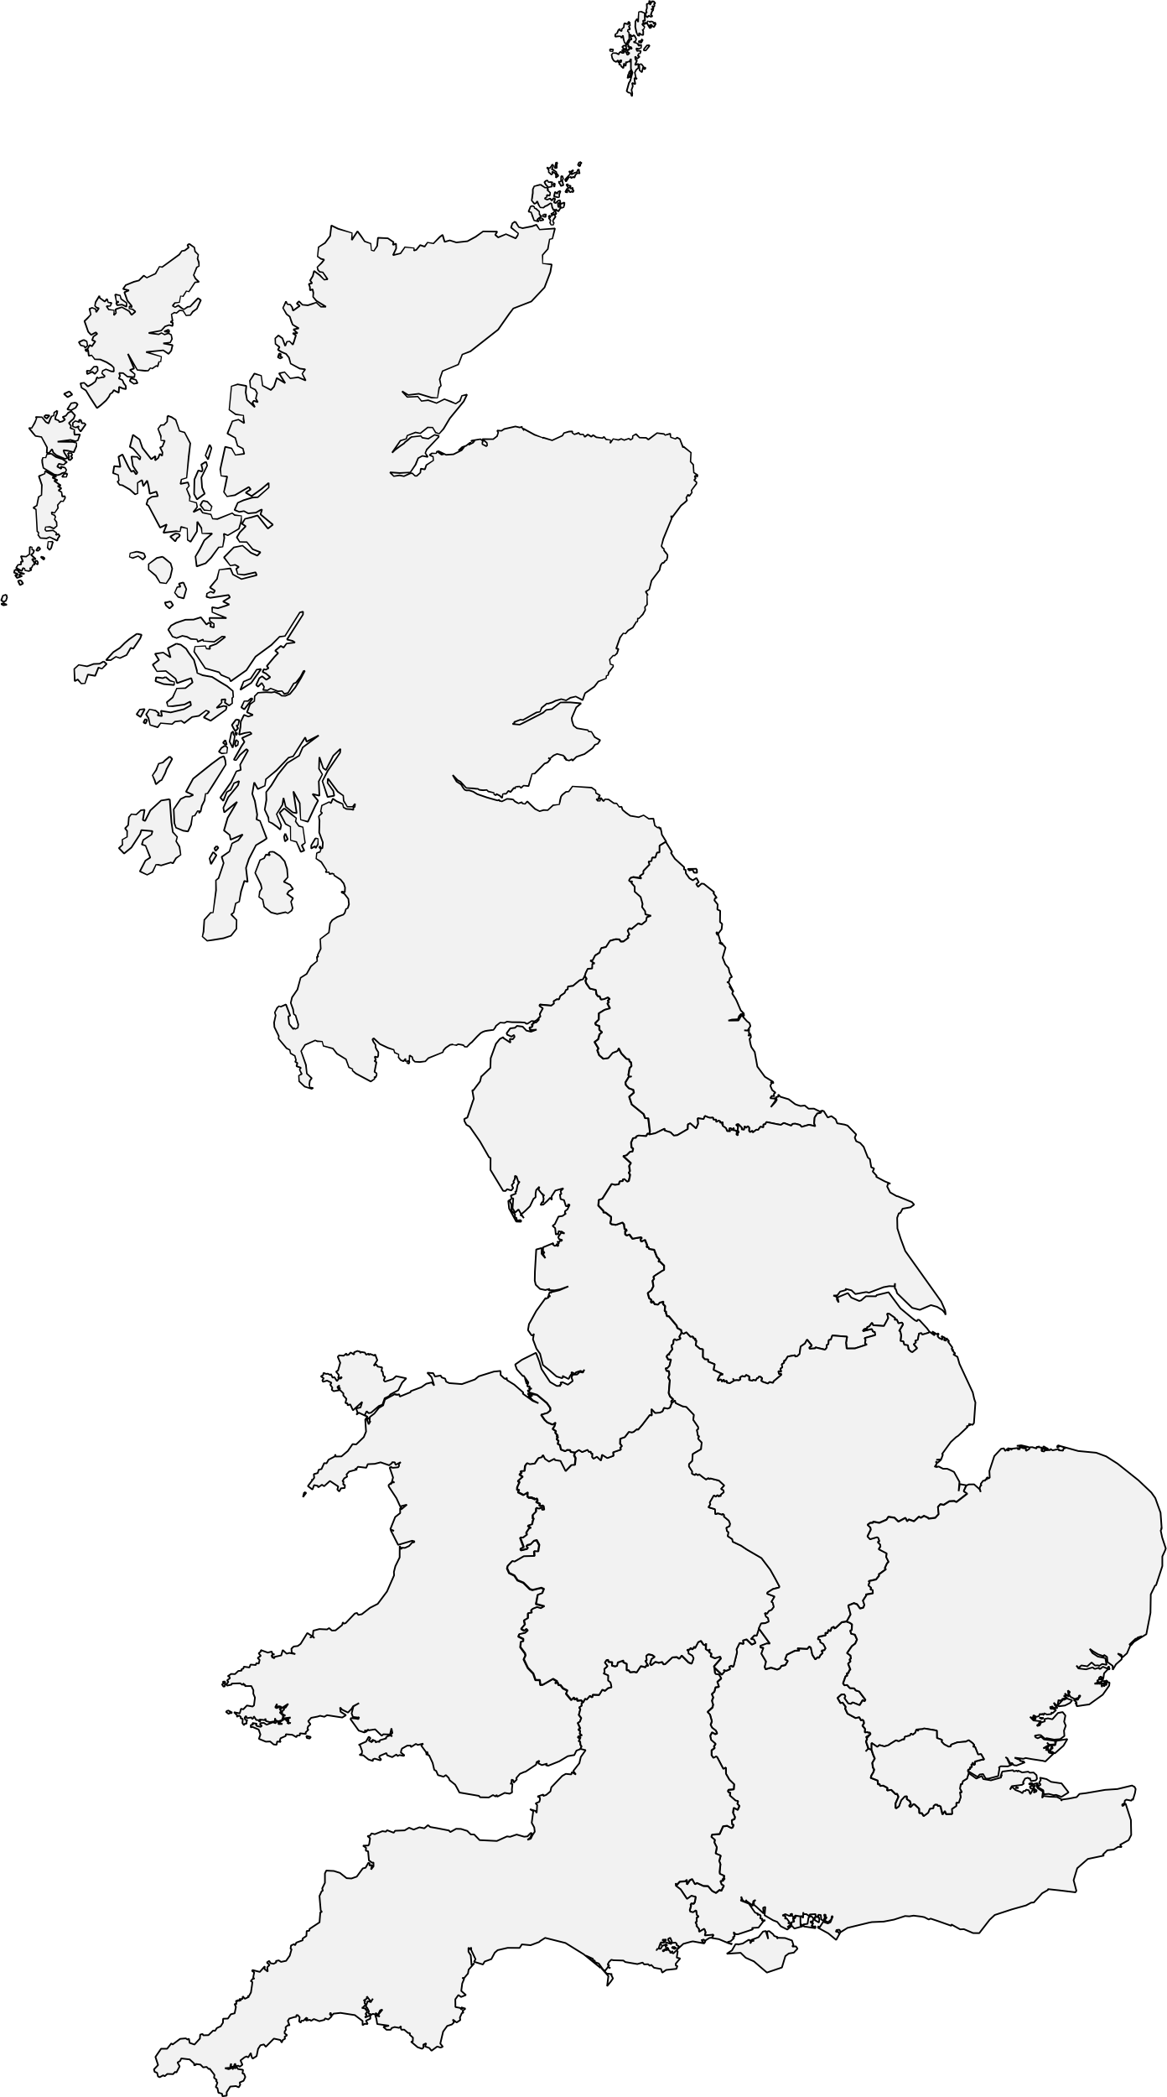

Data Brief
1,042 East of England
1,047 Greater London
455 North East
1054 Yorkshire
13,000
Britain Participants
1450 North West
1161 Scotland
1555 South East
847 East Midlands
1068 South West
701 Wales
1047 West Midlands
1021 Unclear
Research Findings | December, 2022
4

Slide 7
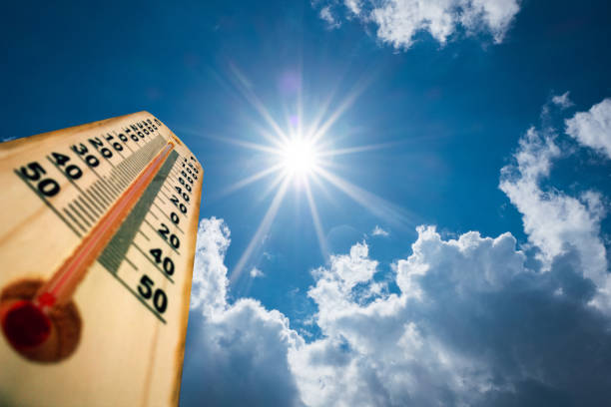
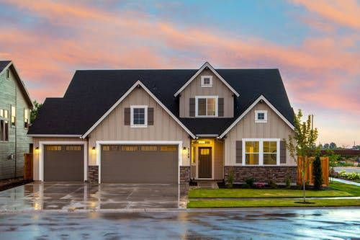

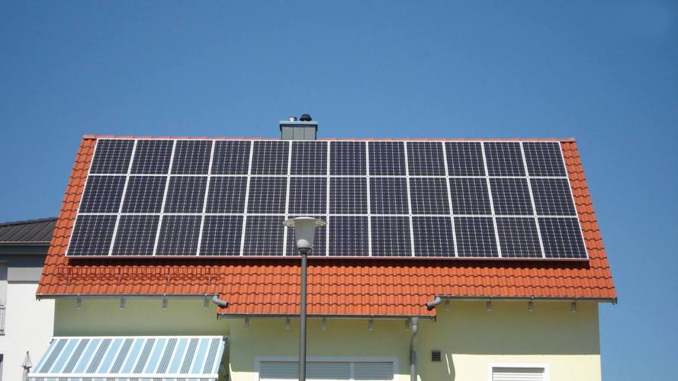


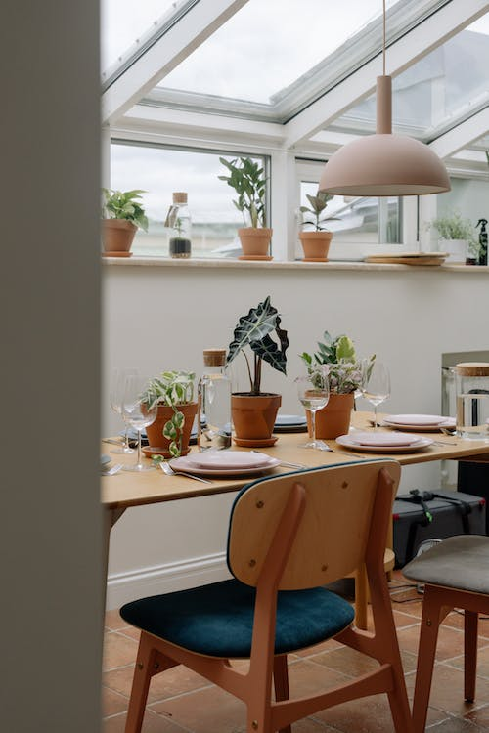
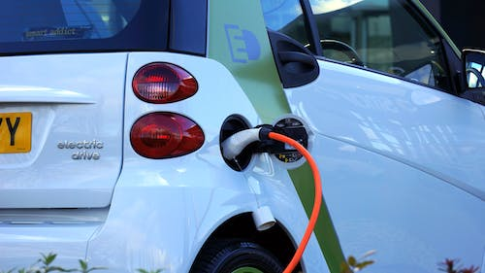
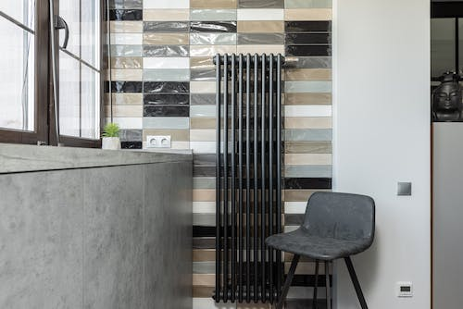


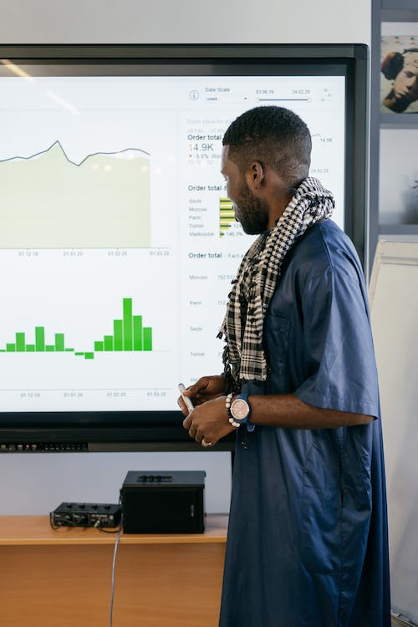



Data Brief
External Temperature
Building Types
Number of Occupants
Has Photovoltaic
Tenure Types
15
Segmentation Variables
Boiler Type for Electricity Consumption
Boiler Type for Gas Consumption
Number of Bedrooms
Floor Area
Has EV
IMD Quintile
Current Energy Rating
Weekday or Weekend
Region
Building Age
Research Findings | December, 2022
5

Slide 8
Data Brief
External Temperature
Building Types
Number of Occupants
Has Photovoltaic
Tenure Types
15
Our next step
Segmentation Variables
Boiler Type for Electricity Consumption
Boiler Type for Gas Consumption
Number of Bedrooms
1. Intro
Floor Area
Has EV
2. Application
3. Findings
4. Next Steps
IMD Quintile
Current Energy Rating
Weekday or Weekend
Region
Building Age
Research Findings | December, 2022
5

Slide 9
1. Intro
2. Application
3. Findings
4. Next Steps

Slide 10



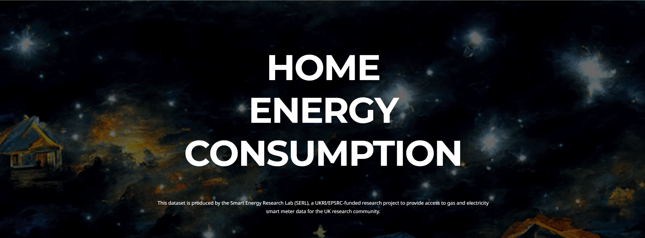
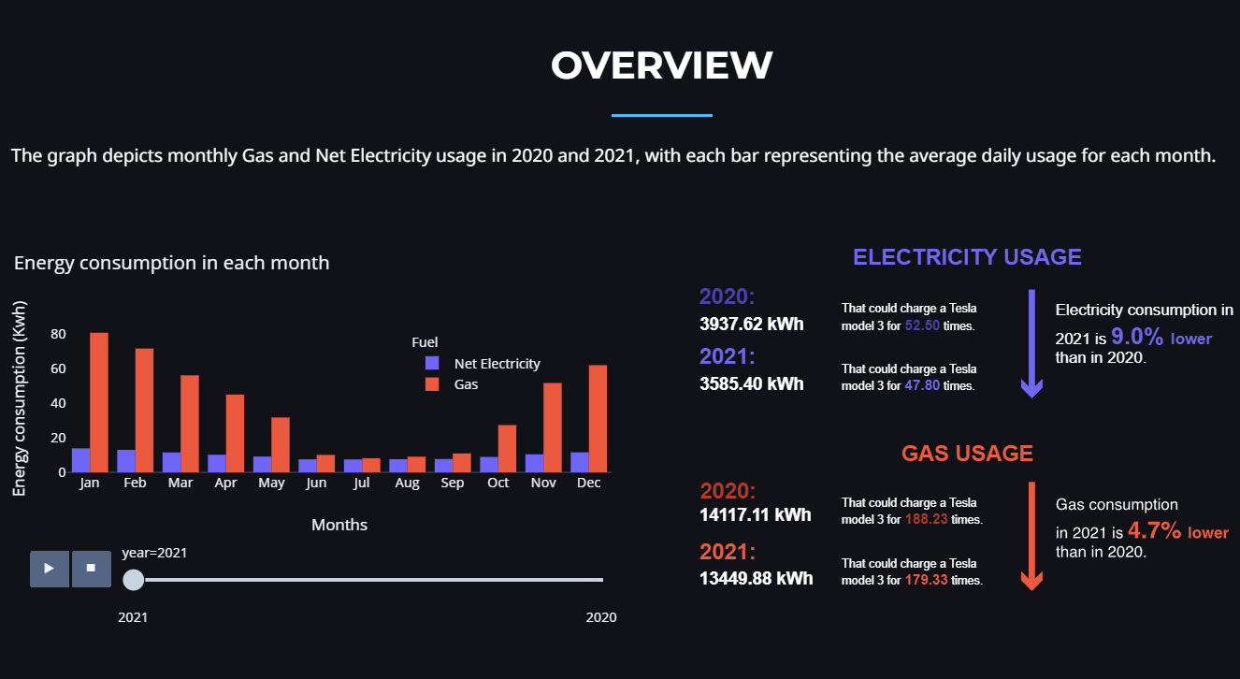
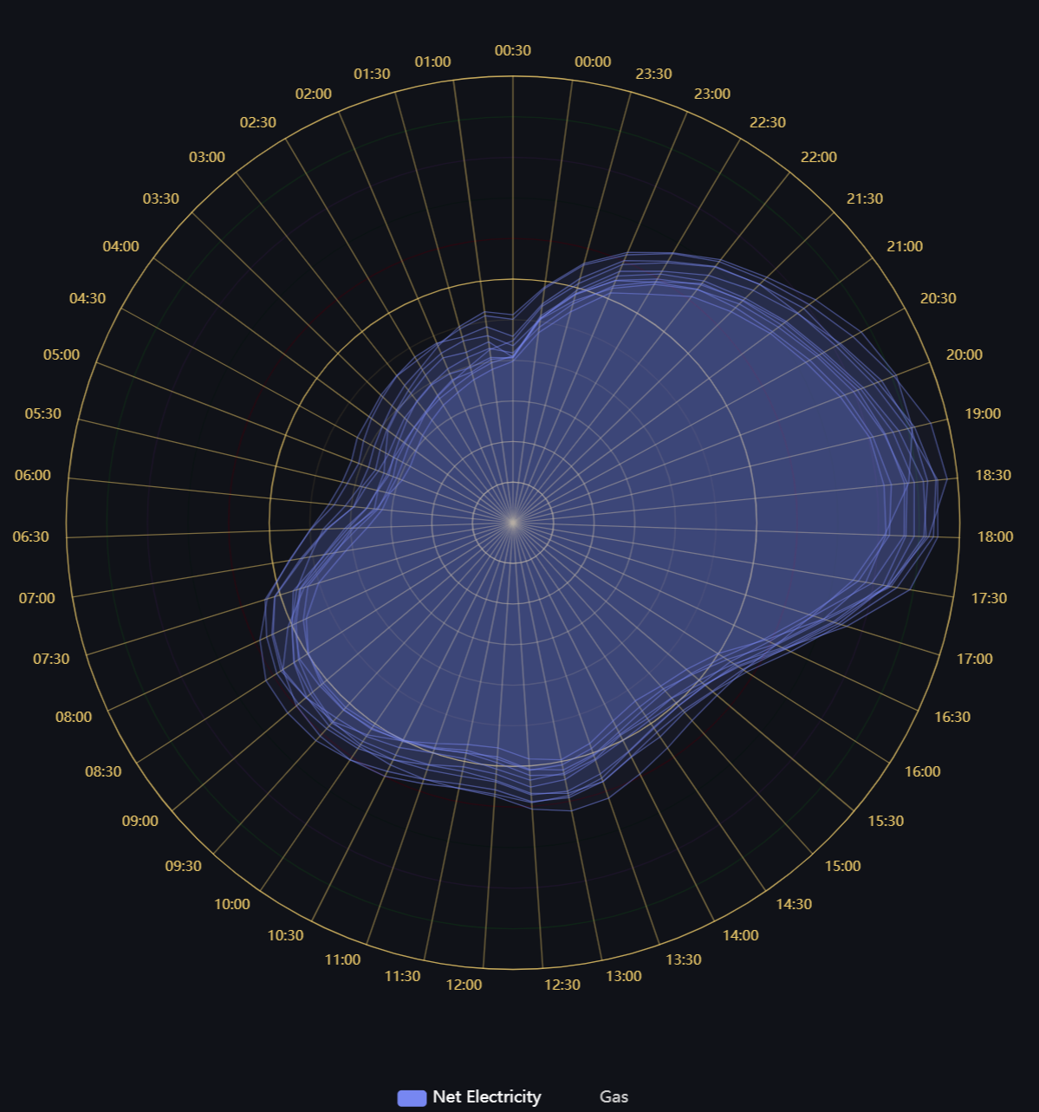
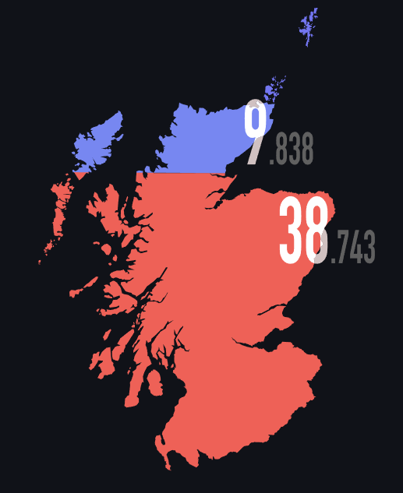
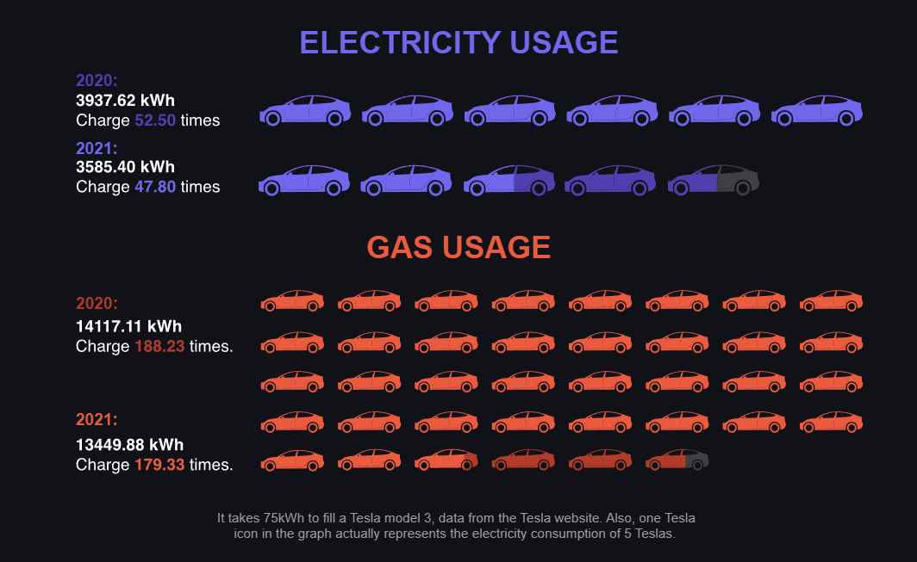
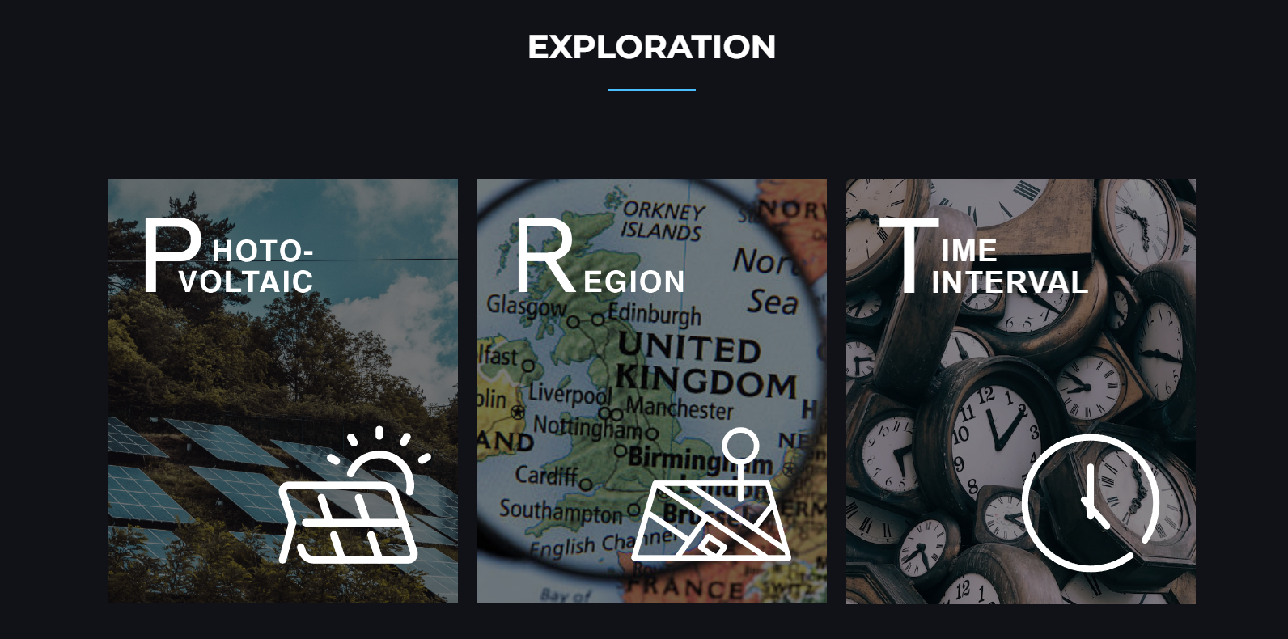
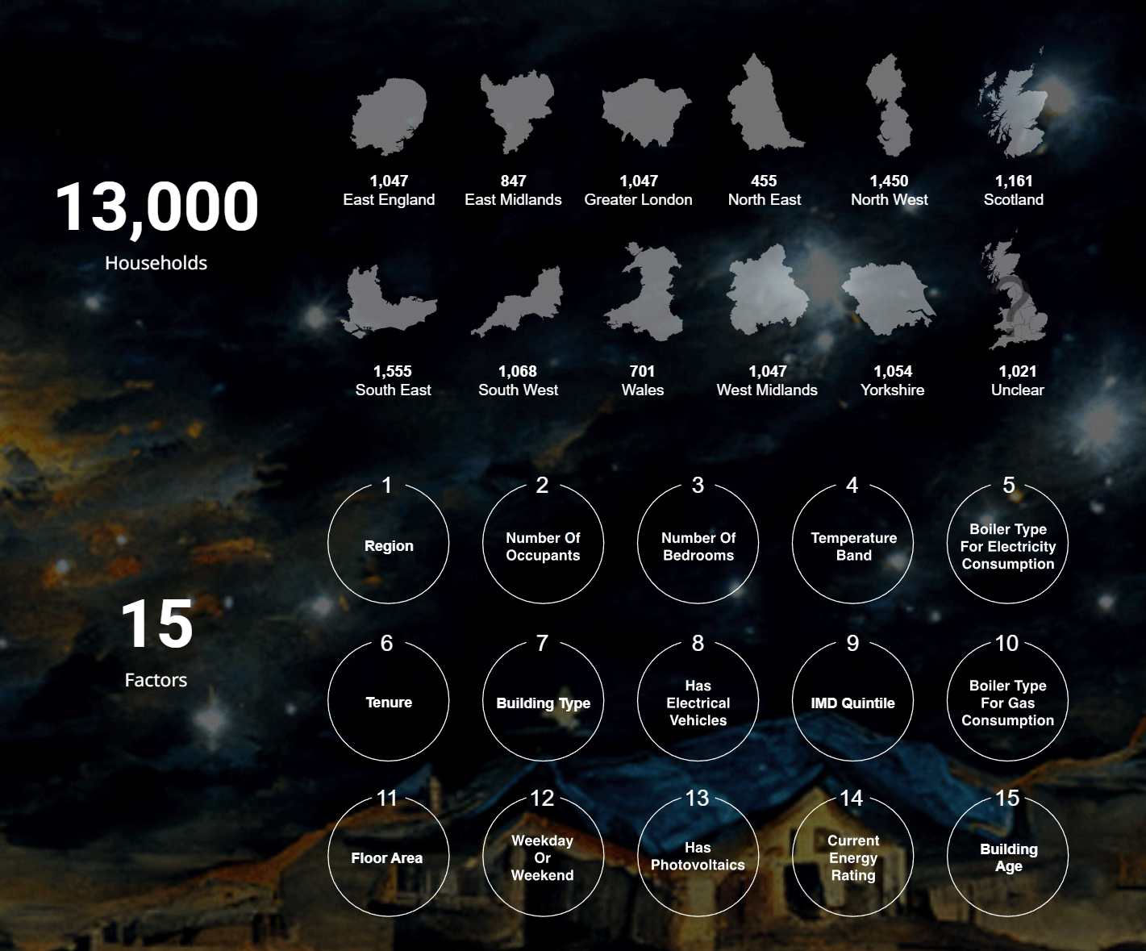
We built a website for users
Based on data owner’s expectations and users’ convenience, we decided to use a website to negotiate with users.
Brief introduction of the data set
Overview of the energy consumption in 2020 and 2021
Exploration of 3 interesting questions about the impact of PV, Region and Time Intervial
1.
2.
3.
kaihuang.one
2. Application
3. Findings
4. Next Steps
Research Findings | December, 2022
6

Slide 11
1. Intro
2. Application
3. Findings
4. Next Steps

Slide 12
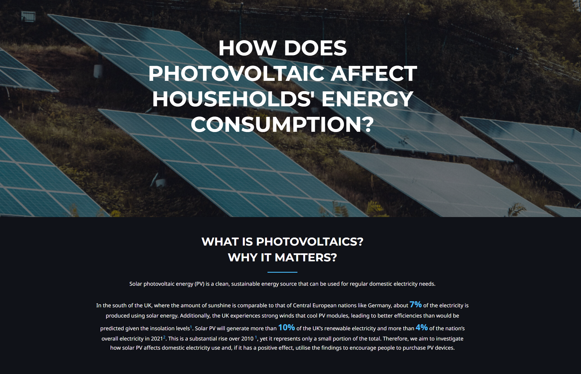
x
e.g. How photovoltaic devices affect households’ energy consumption?
Website: HOME ENERGY CONSUMPTION
we have found that photovoltaic devices have strong impact on household’s energy consumption
Findings
Findings
1. Intro
2. Application
3. Findings
4. Next Steps
Research Findings | December, 2022
7

Slide 13
1. Intro
2. Application
3. Findings
4. Next Steps

Slide 14
Trial
For the next…
Maintain the website
Refine the data analysis findings
Research Findings | December, 2022
8

Slide 15

# Thanks for Watching
Question & Feedback
DS4D Group11
UoE | Design Informatics
E-Mail: s2315477@ed.ac.uk

